Slide 1
Cloud Computing Fundamentals
Presented by
Eng. Janvier NIYITEGEKA
RP/IPRC TUMBA

Slide 2
What is cloud computing?
Cloud computing is a group of IT services which have been presented to a person on the network.
Webopedia's defines cloud computing as being usually typically a kind of computing that utilizes sharing computing resources as opposed to having local servers.
In cloud computing, the word cloud is used as a metaphor for "the web," therefore the phrase cloud computing means "a form of Internet-based computing," where different services — such as servers, storage and applications — are shipped to an organization's computers and devices over the Internet.

Slide 3
CLOUD COMPUTING ARCHITECTURE
There are basically 3 layers in cloud computing: application, platform and lastly infrastructure.
These layers are usually presented in the form of a pyramid with infrastructure at the bottom; platform in the middle; and application at the top of the pyramid.

Slide 4
1) The Bottom Layer
The bottom layer which is infrastructure is also known as ‘infrastructure as a service’ (IaaS).
This is where the things start and where people begin to build. This is the layer where the cloud hosting lives.
Cloud infrastructure is also known to work as a deliver computer infrastructure.
IaaS allows businesses to purchase resources on-demand and as-needed instead of having to buy hardware outright.
IaaS is a form of cloud computing that delivers cloud computing infrastructure that include servers, network, operating systems, and storage, through virtualization technology.
here cloud servers are typically provided to the organization through a dashboard or an API, giving IaaS clients complete control over the entire infrastructure.
The examples of company that provides Cloud infrastructure are Amazon Web Services, GoGrid, Rackspace Cloud, Microsoft Azure, Cisco Metapod, DigitalOcean,..etc.

Slide 5
Con’d
Virtualization is expansively used in IaaS cloud so that users can integrate/decompose physical property to meet increasing or shrinking resource demand from cloud customers.

Slide 6
IaaS Characteristics
Resources are available as a service
Cost varies depending on consumption
Multiple users on a single piece of hardware
Organization retain complete control of the infrastructure
Dynamic and flexible

Slide 7
2) The Middle Layer
The middle layer which is platform is also known as ‘platform as a service’ (PaaS).
Cloud platform services, also known as Platform as a Service (PaaS), provide cloud components to certain software while being used mainly for applications.
PaaS delivers a framework for developers that they can build upon and use to create customized applications.
Third-party vendors provide users with virtual resources to build, deploy, and launch software applications, reducing the need for back-end software development
The examples of company and product of Cloud Platform are Google App Engine, Salesforce Platform, Heroku, Mosso, Force.com, Windows Azure,…..etc.
In contrast to the Cloud Application, this layer is where the users build up their applications to increase the flexibility and control.
All servers, storage, and networking can be managed by the enterprise or a third-party provider while the developers can maintain management of the applications. This avoids long-term investments in development time
The delivery model of PaaS is similar to SaaS, except instead of delivering the software over the internet, PaaS provides a platform for software creation.

Slide 8
3) The Top Layer
The top layer which is an application is also known as ‘software as a service’ (SaaS).
SaaS utilizes the internet to deliver applications, which are managed by a third-party vendor, to its users.
A majority of SaaS applications run directly through your web browser, which means they do not require any downloads or installations on the client side.
The part of company that is involved is the public email providers such as Gmail, Hotmail, Yahoo Mail, etc.
Usually, users can only get the pre-defined functions and cannot access more than that.
users can use the application as it appears; and they have no knowledge or any control to the application.
The advantages however are that it is free, greatly reducing the time and money spent on tedious tasks such as installing, managing, and upgrading software..
Saas include Google Workspace, Dropbox, Cisco WebEx, Concur, GoToMeeting, zoom meeting,…etc.

Slide 9
SaaS Characteristics
Managed from a central location
Hosted on a remote server
Accessible over the internet
Users not responsible for hardware or software updates

Slide 10
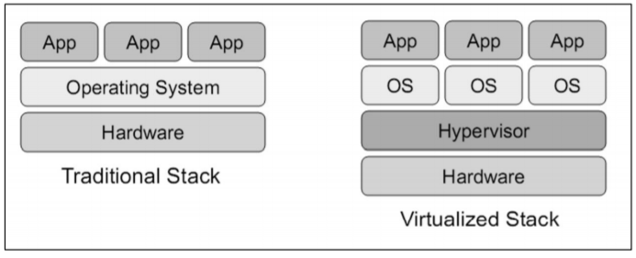
VIRTUALISATION AND RESOURCE MANAGEMENT

Slide 11
VIRTUALISATION AND RESOURCE MANAGEMENT
Virtualization is the process of simulating hardware, so that several operating systems could be run on a single machine.
Most servers use only about 10 – 20 % if dedicated to a single client.
In order to maximize the usage of servers in the cloud, Virtual Machines(simulation of hardware to create an environment similar to that of physical hardware) are used.
One server could be hosting several VMs and each VM is dedicated to one client only.
VMs could then be migrated to others servers based on resource management (CPU, Memory or Storage usage).
The main aim of virtualization is to provide strong isolation, security, performance and simplicity.

Slide 12
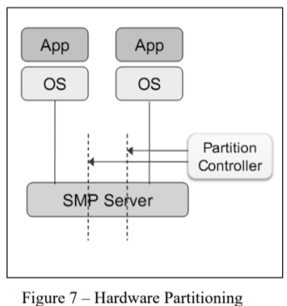
Types of Virtualization Technology
1) Hardware Partition: hardware (CPU, Memory and storage) is partitioned by using a Partition Controller.
Each partition has their own CPU/Memory and independent Operating System installed.
The disadvantage of this method is the lack of flexibility for the management of the resources in real-time.
Once the system is set-up, and a user finds that there is need, for example, of more memory, the system cannot be reconfigured.

Slide 13
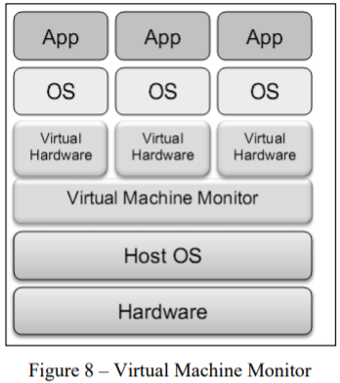
2) Virtual Machine Monitoring
An application known as VMM is installed on the Host OS, and which allows to create several VM having each their own OS.
In this type of virtualization, the kernel of host OS is not modified, as compared to Hardware partition.
It allows each VM to have an OS independent of the host OS.
The downsides of this type is the low efficiency and high cost of hardware instruction translation.

Slide 14
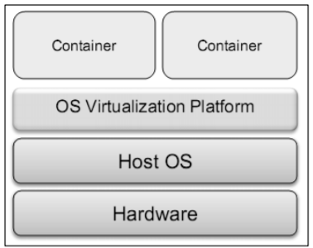
3) OS Virtualization
one OS instance is installed on a single host.
A virtualization platform is installed on top of the host OS.
The virtualization platform then offers the possibility to create containers to host virtual OS.
The benefits of this deployment is the low cost and possibility of running hundreds of VPS (Virtual Private Server) on a single server.

Slide 15
Typical IoT Cloud Platforms
Cisco IoT Cloud Connect
Salesforce IoT Cloud
Kaa IoT Platform
Oracle IoT Platform
Thingspeak
Microsoft Azure IoT Suite
Thingworx 8
Google Cloud
IBM Watson IoT Platform
AWS IoT Platform
Google Cloud’s IoT Platform

Slide 16
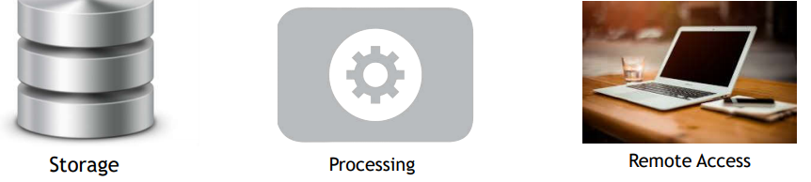
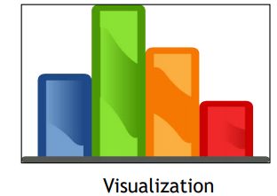
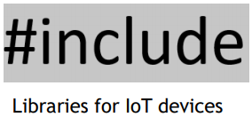
What does a Cloud Platform for IoT offer?

Slide 17
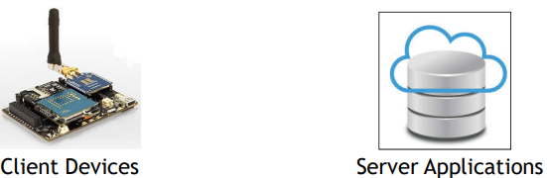
Libraries
Makes cloud platforms easier to use
Offers various utilities and methods to access the cloud platform
Offered in various languages and device platforms

Slide 18
Thank You!!!

